Slide 1




An Introduction to Pathway Analysis
Alex Sánchez
Statistics and Bioinformatics Research Group
Statistics department, Universitat de Barelona
Statistics and Bioinformatics Unit
Vall d’Hebron Institut de Recerca

Slide 2
Outline
Presentation
Introduction and Background
The problem: Interpreting gene lists
Annotations and annotation databases
The Gene Ontology Resource
Gene list analysis using the GO and relatives
Existing tools for pathway analysis

Slide 3
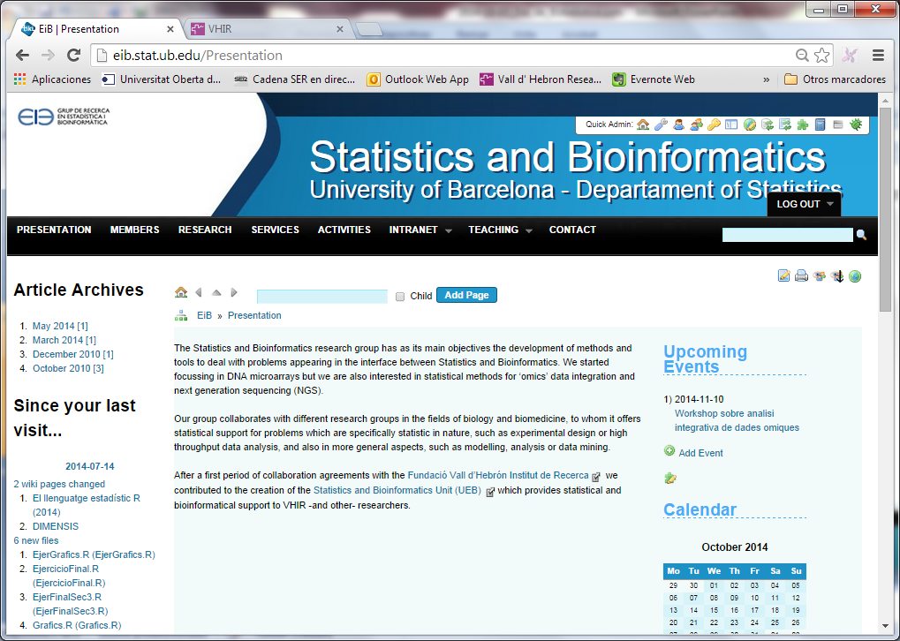
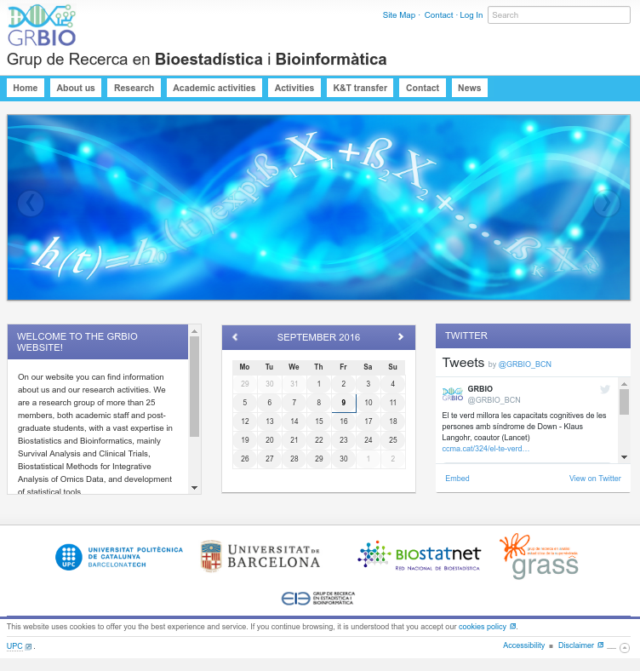
(Bio)Statistics and Bioinformatics Research groups

Slide 4


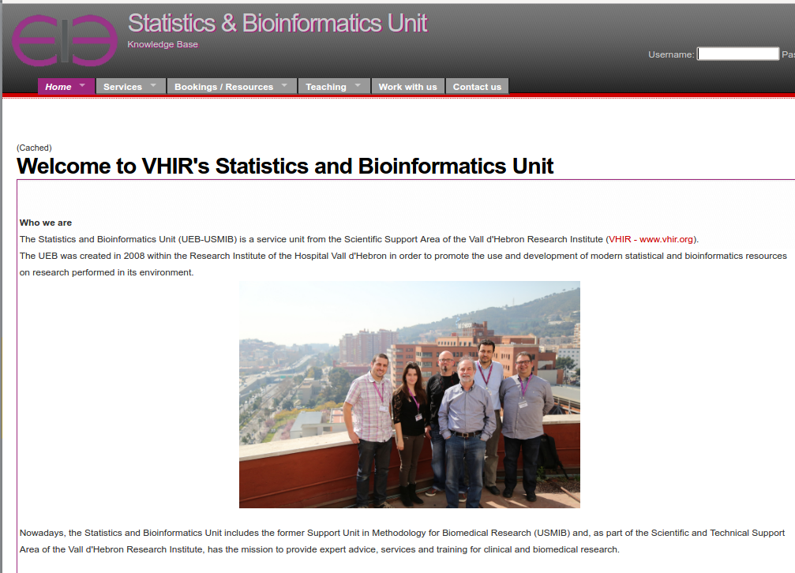
The Statistics and Bioinformatics Unit

Slide 5
Introduction & Background

Slide 6


The main question
We might sart by asking
What is LIFE?
A hard question to deal with
What if we ask:
What is life?

Slide 7
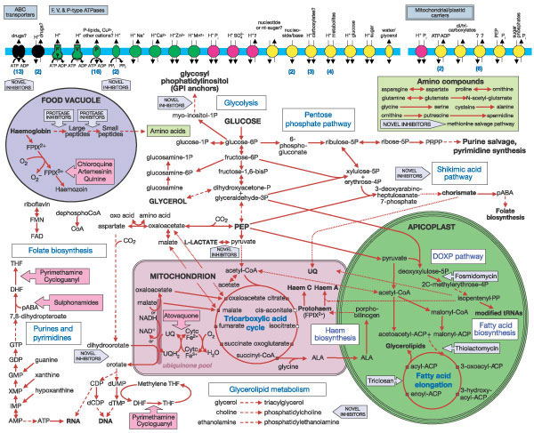
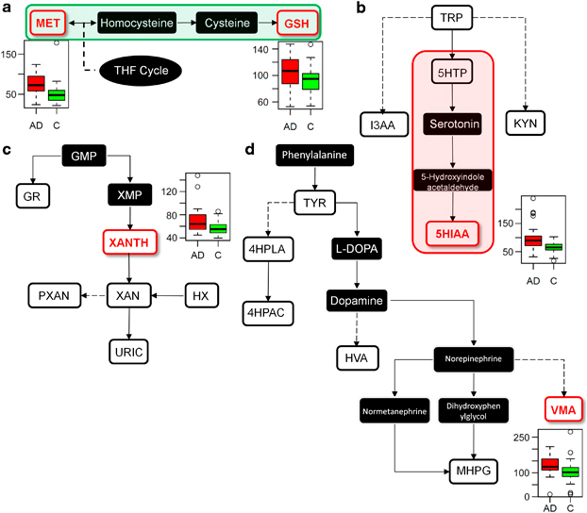
Health, disease and pathways
Metabolism is a complex network of chemical reactions within the confines of a cell that can be analyzed in self-contained parts called pathways
One can generally assume that “normal” metabolism is what happens in healthy state or, reciprocally, that disease can be associated with some type of alteration in metabolism.
Pathways altered in ALZHEIMER disease
Characterization of disease can be atempted by studying how this affects or disrupts pathways
That’s what Pathway Analysis is about (more or less)

Slide 8
Pathway Analysis
The term Pathway or Network Analysis denotes any analytic technique that benefits from biological pathway or molecular network information to gain insight into a biological system. (Creixell et alt, Nature Methods 2015 (12 (7))
To be more specific, Pathway Analysis methods rely on high throughput information provided by omics technologies to:
Contextualize findings to help understand the mechanism of disease
Identify genes/proteins associated with the etiology of a disease
Predict drug targets
Understand how to therapeutically intervene in disease processes
Conduct target literature searches
Integrate diverse biological information

Slide 9
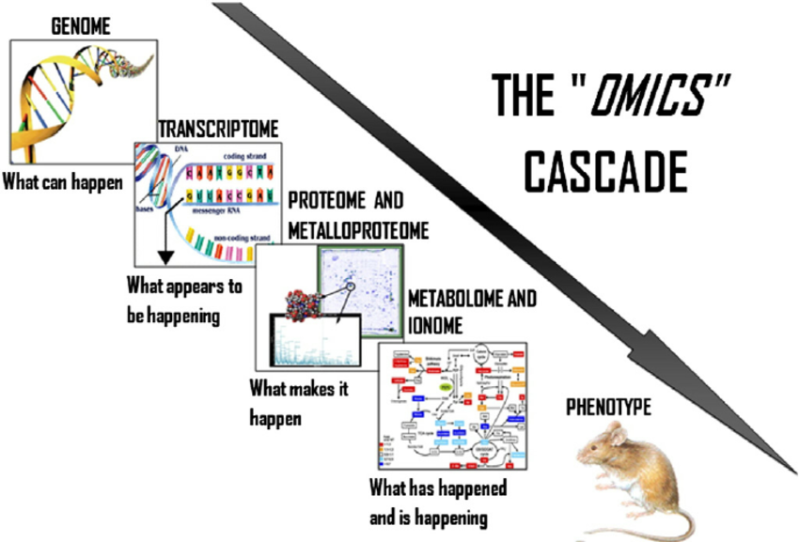
Biology: The “omes”

Slide 10
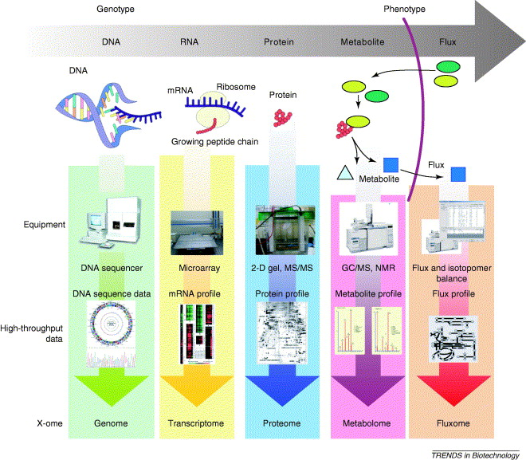
(Bio)technology: The “omics”

Slide 11
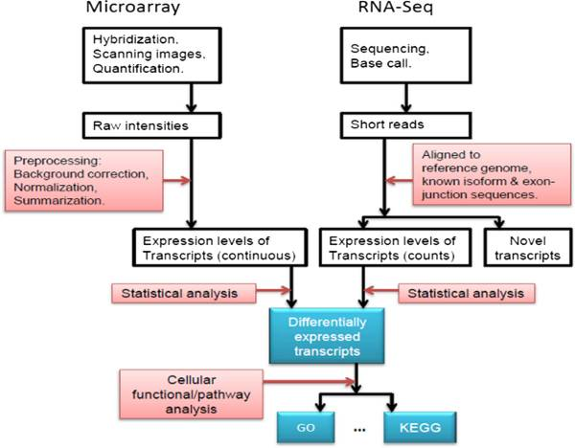
The life-cycle of an omics-based study
Pathway Analysis !!!
Fang et al. Cell Biosci. 2012; 2: 26.

Slide 12
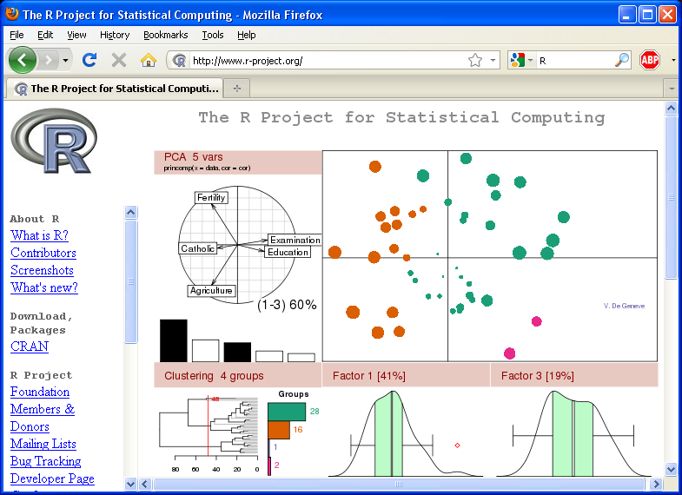
The R project for Statistical Computing

Slide 13


What is R
The S language was developed in 1976 at Bell Laboratories by John Chambers to ...
facilitate interactive exploration and visualization of data of varying complexity.
allow them to perform on all types of statistical analyzes.
S language was (and is) commercial.
R ("GNU" S) is born as a free alternative to S.

Slide 14
Why R?
Free (like in free bier)
High quality methods implemented
Plattform independent
Linux, Mac, Other
Constantly evolving
New version /6 months
Statistical tool
Modern
Most existing methods
(new method → R)
Great graphics.
Programming language
Powerful & Flexible
Open source
Great for repetitive tasks

Slide 15
Why not R
Console-based interface
But GUI projects available
R-commander, DeduceR
Community-based quality control
No company behind (no money back)
But thousands of users for most packages
Constantly evolving
One new version every 6 months

Slide 16
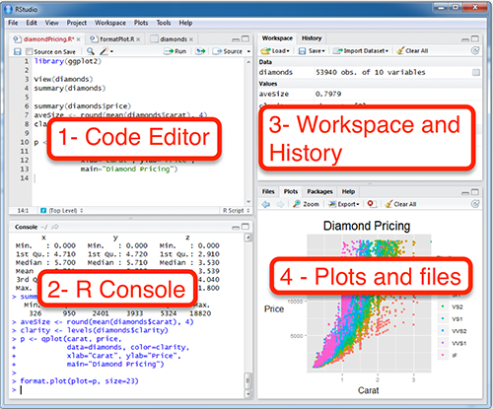

R interfaces - Rstudio

Slide 17

Bioconductor
An open source and open development software project for the analysis and comprehension of genomic data.
Started in 2001. The core team is based primarily at the Fred Hutchinson Cancer Research Center.
Primarily based on the R programming language.
There are two releases of Bioconductor every year.
Started with 15packages
NOW THERE ARE MORE THAN 1000

Slide 18
Using Bioconductor
Essentially Bioconductor is a set of R packages
A bioconductor package
Implements a different, new functionality
To manipulate or make tests on omics data
To use annotations
…
It can also be an Annotations database
Or even an experimental dataset
BioC also provides training materials

Slide 19
Managing Gene Lists

Slide 20
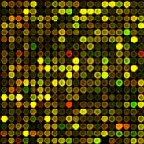
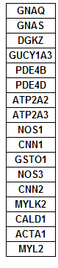
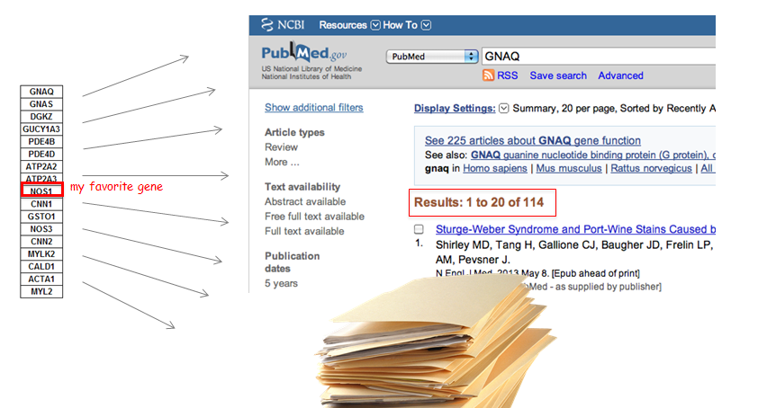
The (in)famous “where to now?” question
You obtained a list of features. What’s next?
Select some genes for validation?
Follow up experiments on some genes/proteins/…?
Publish a huge table with all results?
Try to learn on all features in the list?
?

Slide 21
From gene lists to Pathway Analysis
Gene lists contain useful information
This can be extracted from databases
Generically described as Gene Annotation
Besides, we may obtain information from the analysis of gene sets
Genes don’t act individually, rather in groups→ More realistic approach
There are less gene sets than individual genes → Relatively simpler to manage
Generically described as Pathway Analysis

Slide 22
Case study 1
Lists AvsB, AvsL and BvsL contain the IDs of genes selected by being differentially expressed between three types of breast cancer tumors.
Farmer P, Bonnefoi H, Becette V, Tubiana-Hulin M et al. Identification of molecular apocrine breast tumours by microarray analysis. Oncogene 2005 Jul 7;24(29):4660-71. PMID: 15897907
See the analysis that generates the list in: https://github.com/alexsanchezpla/scripts/tree/master/Exemple_Analisis_BioC

Slide 23
Case study 2
One hundred sixty-four genes found to be upregulated in CD4+/CD62L- T cells relative to CD4+/CD62L+ T cells.
Cutting edge: L-selectin (CD62L) expression distinguishes small resting memory CD4+ T cells that preferentially respond to recall antigen.
Hengel RL et al.
J Immunol 2003 Jan 1;170(1):28-32

Slide 24
Gene Lists and Annotations

Slide 25
Gene and Protein Identifiers
Identifiers (IDs) are ideally unique, stable names or numbers that help track database records
E.g. Social Insurance Number, Entrez Gene ID 41232
But, information on features is stored in many databases…
Genes have many IDs
Records for: Gene, DNA, RNA, Protein
Important to recognize the correct record type
E.g. Entrez Gene records don’t store sequence. They link to DNA regions, RNA transcripts and proteins e.g. in RefSeq, which stores sequence.

Slide 26
Common Identifiers
Gene
Ensembl ENSG00000139618
Entrez Gene 675
Unigene Hs.34012
RNA transcript
GenBank BC026160.1
RefSeq NM_000059
Ensembl ENST00000380152
Protein
Ensembl ENSP00000369497
RefSeq NP_000050.2
UniProt BRCA2_HUMAN or A1YBP1_HUMAN
IPI IPI00412408.1
EMBL AF309413
PDB 1MIU
Species-specific
HUGO HGNC BRCA2
MGI MGI:109337
RGD 2219
ZFIN ZDB-GENE-060510-3
FlyBase CG9097
WormBase WBGene00002299 or ZK1067.1
SGD S000002187 or YDL029W
Annotations
InterPro IPR015252
OMIM 600185
Pfam PF09104
Gene Ontology GO:0000724
SNPs rs28897757
Experimental Platform
Affymetrix 208368_3p_s_at
Agilent A_23_P99452
CodeLink GE60169
Illumina GI_4502450-S
Red = Recommended

Slide 27
Identifier Mapping
There are many IDs!
Software tools recognize only a handful
May need to map from your gene list IDs to standard IDs
Four main uses
Searching for a favorite gene name
Link to related resources
Identifier translation
E.g. Proteins to genes, Affy ID to Entrez Gene
Merging data from different sources
Find equivalent records

Slide 28
ID Challenges
Avoid errors: map IDs correctly
Beware of 1-to-many mappings
Gene name ambiguity – not a good ID
e.g. FLJ92943, LFS1, TRP53, p53
Better to use the standard gene symbol: TP53
Excel error-introduction
OCT4 is changed to October-4 (paste as text)
Problems reaching 100% coverage
E.g. due to version issues
Use multiple sources to increase coverage
Zeeberg BR et al. Mistaken identifiers: gene name errors can be introduced inadvertently when using Excel in bioinformatics BMC Bioinformatics. 2004 Jun 23;5:80

Slide 29
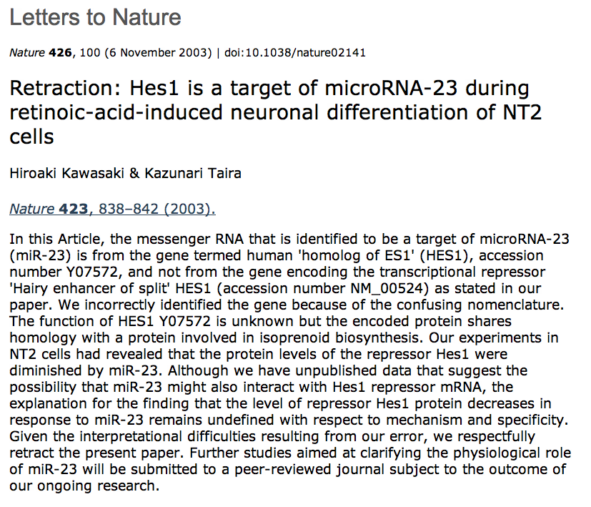

Slide 30
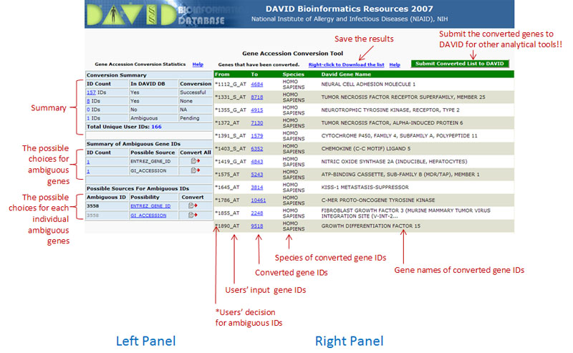
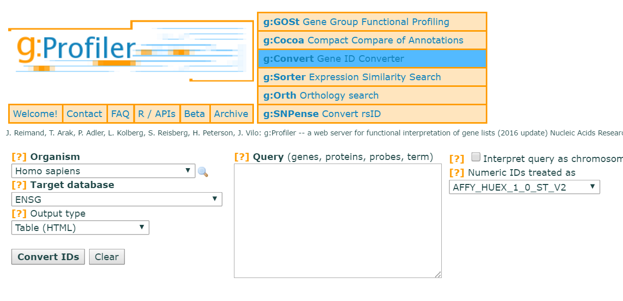
Use ID converters to prepare list

Slide 31
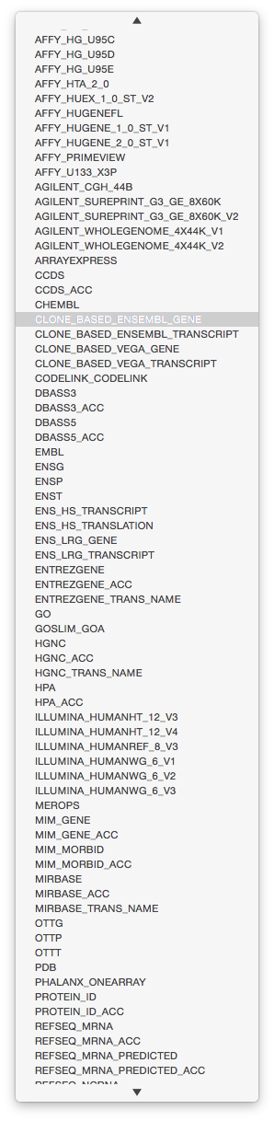
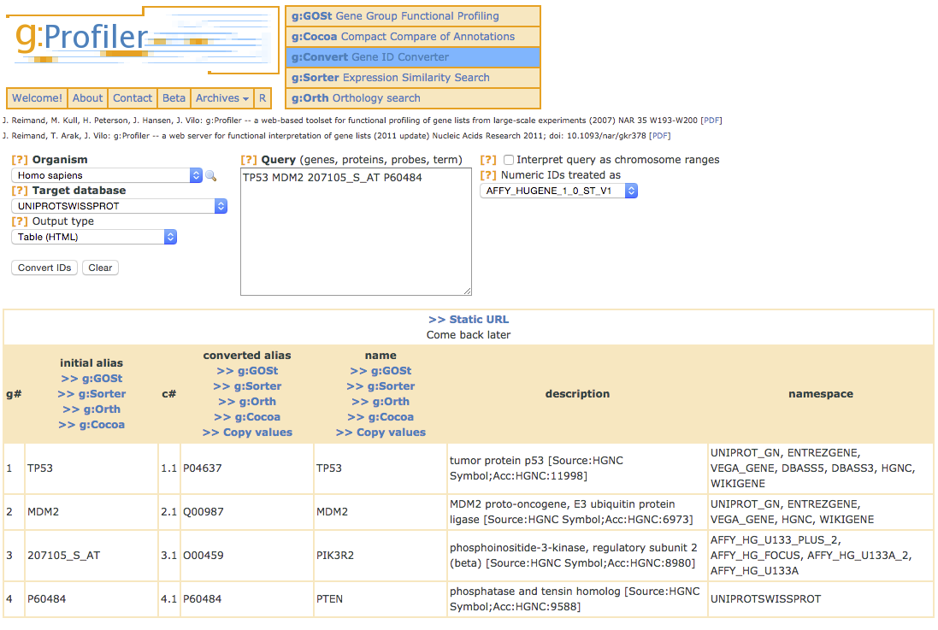
ID Mapping Services
Input gene/protein/transcript IDs (mixed)
Type of output ID
g:Convert
http://biit.cs.ut.ee/gprofiler/gconvert.cgi
Ensembl Biomart
http://www.ensembl.org

Slide 32
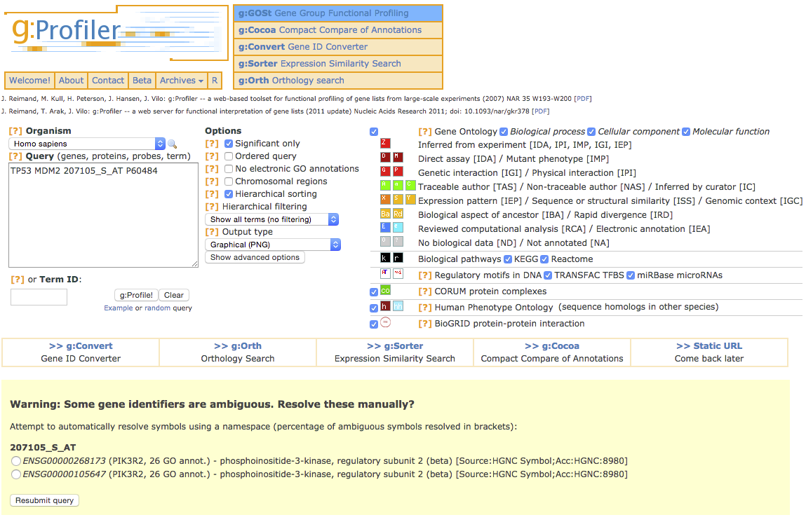
Beware of ambiguous ID mappings

Slide 33
Recommendations
For proteins and genes
(doesn’t consider splice forms)
Map everything to Entrez Gene IDs or Official Gene Symbols using an appropriate tool, such as R/Bioc, or a spreadsheet if no other option.
If 100% coverage desired, manually curate missing mappings using multiple resources
Be careful of Excel auto conversions – especially when pasting large gene lists!
Remember to format cells as ‘text’ before pasting

Slide 34
The Gene Ontology (at last)

Slide 35
Where is pathway information?
Pathways
Gene Ontology biological process, pathway databases e.g. Reactome
Other annotations
Gene Ontology molecular function, cell location
Chromosome position
Disease association
DNA properties (TF binding sites, gene structure (intron/exon), SNPs, …)
Transcript properties (Splicing, 3’ UTR, microRNA binding sites, …)
Protein properties (Domains, 2ry and 3ry structure, PTM sites)
Interactions with other genes

Slide 36
What is the Gene Ontology (GO)?
Set of biological phrases (terms) which are applied to genes:
protein kinase
apoptosis
membrane
Dictionary: term definitions
Ontology: A formal system for describing knowledge
www.geneontology.org

Slide 37
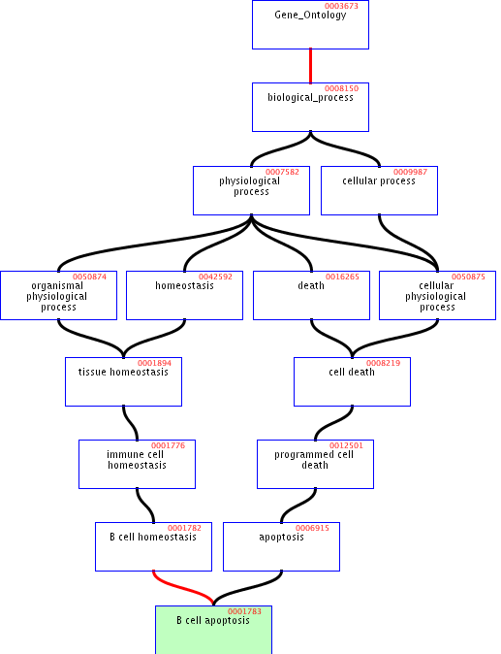
GO Structure
Terms are related within a hierarchy
is-a
part-of
Describes multiple levels of detail of gene function
Terms can have more than one parent or child

Slide 38
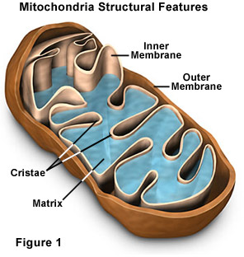
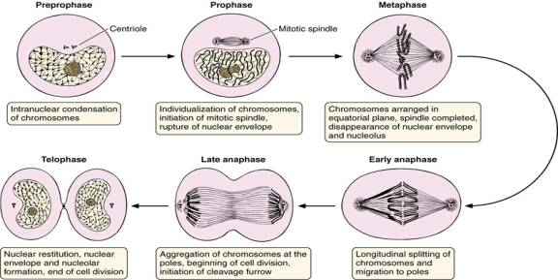
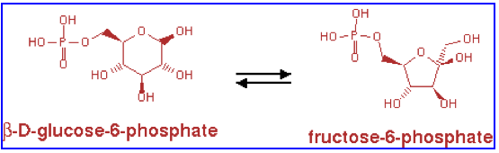
What is covered by the GO?
GO terms divided into three aspects:
cellular component
molecular function
biological process
glucose-6-phosphate isomerase activity
Cell division

Slide 39
Part 1/2: Terms
Where do GO terms come from?
GO terms are added by editors at EBI and gene annotation database groups
Terms added by request
Experts help with major development
 | Jun 2012 | Apr 2015 | increase
Biological process | 23,074 | 28,158 | 22%
Molecular function | 9,392 | 10,835 | 15%
Cellular component | 2,994 | 3,903 | 30%
total | 37,104 | 42,896 | 16%

Slide 40
Part 2/2: Annotations
Genes are linked, or associated, with GO terms by trained curators at genome databases
Known as ‘gene associations’ or GO annotations
Multiple annotations per gene
Some GO annotations created automatically (without human review)

Slide 41
Hierarchical annotation
Genes annotated to specific term in GO automatically added to all parents of that term
AURKB

Slide 42
Annotation Sources
Manual annotation
Curated by scientists
High quality
Small number (time-consuming to create)
Reviewed computational analysis
Electronic annotation
Annotation derived without human validation
Computational predictions (accuracy varies)
Lower ‘quality’ than manual codes
Key point: be aware of annotation origin

Slide 43



Evidence Types
Experimental Evidence Codes
EXP: Inferred from Experiment
IDA: Inferred from Direct Assay
IPI: Inferred from Physical Interaction
IMP: Inferred from Mutant Phenotype
IGI: Inferred from Genetic Interaction
IEP: Inferred from Expression Pattern
Author Statement Evidence Codes
TAS: Traceable Author Statement
NAS: Non-traceable Author Statement
Curator Statement Evidence Codes
IC: Inferred by Curator
ND: No biological Data available
Computational Analysis Evidence Codes
ISS: Inferred from Sequence or Structural Similarity
ISO: Inferred from Sequence Orthology
ISA: Inferred from Sequence Alignment
ISM: Inferred from Sequence Model
IGC: Inferred from Genomic Context
RCA: inferred from Reviewed Computational Analysis
IEA: Inferred from electronic annotation
http://www.geneontology.org/GO.evidence.shtml

Slide 44
Species Coverage
All major eukaryotic model organism species and human
Several bacterial and parasite species through TIGR and GeneDB at Sanger
New species annotations in development
Current list:
http://www.geneontology.org/GO.downloads.annotations.shtml

Slide 45
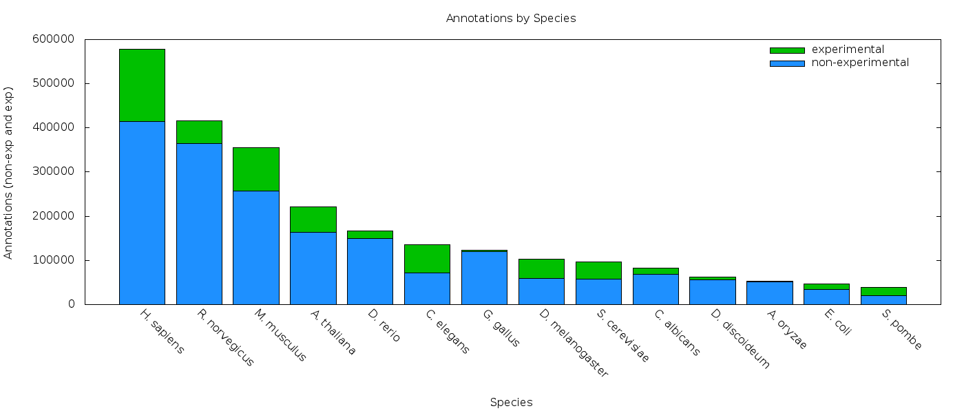
Variable Coverage
Experimental
Non-experimental
www.geneontology.org, Apr 2015

Slide 46
Contributing Databases
Berkeley Drosophila Genome Project (BDGP)
dictyBase (Dictyostelium discoideum)
FlyBase (Drosophila melanogaster)
GeneDB (Schizosaccharomyces pombe, Plasmodium falciparum, Leishmania major and Trypanosoma brucei)
UniProt Knowledgebase (Swiss-Prot/TrEMBL/PIR-PSD) and InterPro databases
Gramene (grains, including rice, Oryza)
Mouse Genome Database (MGD) and Gene Expression Database (GXD) (Mus musculus)
Rat Genome Database (RGD) (Rattus norvegicus)
Reactome
Saccharomyces Genome Database (SGD) (Saccharomyces cerevisiae)
The Arabidopsis Information Resource (TAIR) (Arabidopsis thaliana)
The Institute for Genomic Research (TIGR): databases on several bacterial species
WormBase (Caenorhabditis elegans)
Zebrafish Information Network (ZFIN): (Danio rerio)

Slide 47
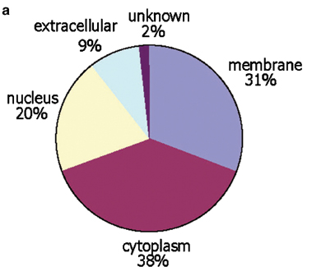
GO Slim Sets
GO has too many terms for some uses
Summaries (e.g. Pie charts)
GO Slim is an official reduced set of GO terms
Generic, plant, yeast
Crockett DK et al. Lab Invest. Nov. 2005; 85(11):1405-15

Slide 48
GO Software Tools
GO resources are freely available to anyone without restriction
ontologies, gene associations and tools developed by GO
Other have used GO to create versatile tools
https://omictools.com/gene-ontologies-category
https://omictools.com/gene-set-analysis-category

Slide 49
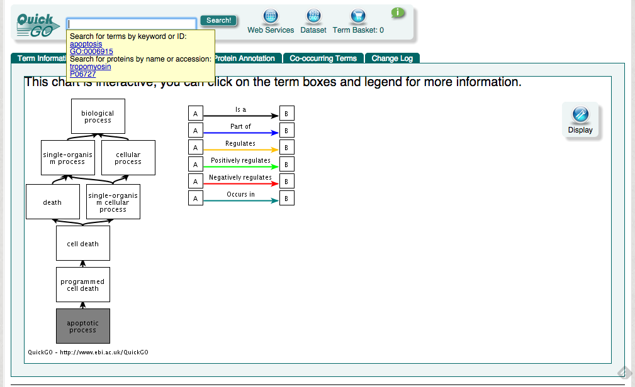
Accessing GO: QuickGO
http://www.ebi.ac.uk/QuickGO/

Slide 50
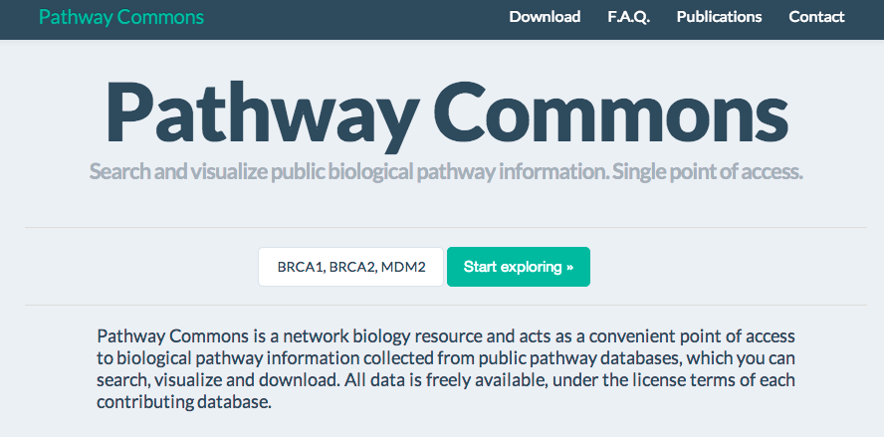
Pathway Databases
http://www.pathguide.org/ lists ~550 pathway related databases
MSigDB: http://www.broadinstitute.org/gsea/msigdb/
http://www.pathwaycommons.org/ collects major ones

Slide 51
Sources of Gene Attributes
Ensembl BioMart (general)
http://www.ensembl.org
Entrez Gene (general)
http://www.ncbi.nlm.nih.gov/sites/entrez?db=gene
Model organism databases
E.g. SGD: http://www.yeastgenome.org/

Slide 52
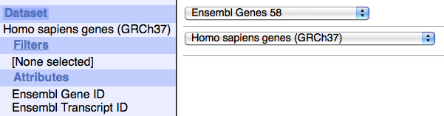
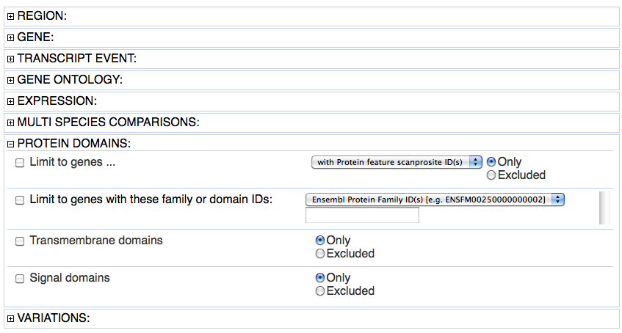
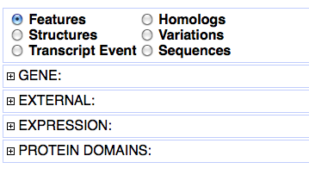
Ensembl BioMart
Convenient access to gene list annotation
Select genome
Select filters
Select attributes
to download
www.ensembl.org

Slide 53
Pathway Analysis
Overrepresentation Analysis
Gene Set Enrichment Analysis

Slide 54
Pathway and Network Analysis
Any type of analysis that involves pathway or network information
Helps gain mechanistic insight into ‘omics’ data
Identifying a master regulator, drug targets, characterizing pathways active in a sample
Most commonly applied to help interpret lists of genes
Most popular type is pathway enrichment analysis, but many others are useful

Slide 55
Benefits of Pathway Analysis
Easier to interpret
Familiar concepts e.g. cell cycle
Identifies possible causal mechanisms
Predicts new roles for genes
Improves statistical power
Fewer tests, aggregates data from multiple genes into one pathway
More reproducible
E.g. gene expression signatures
Facilitates integration of multiple data types

Slide 56
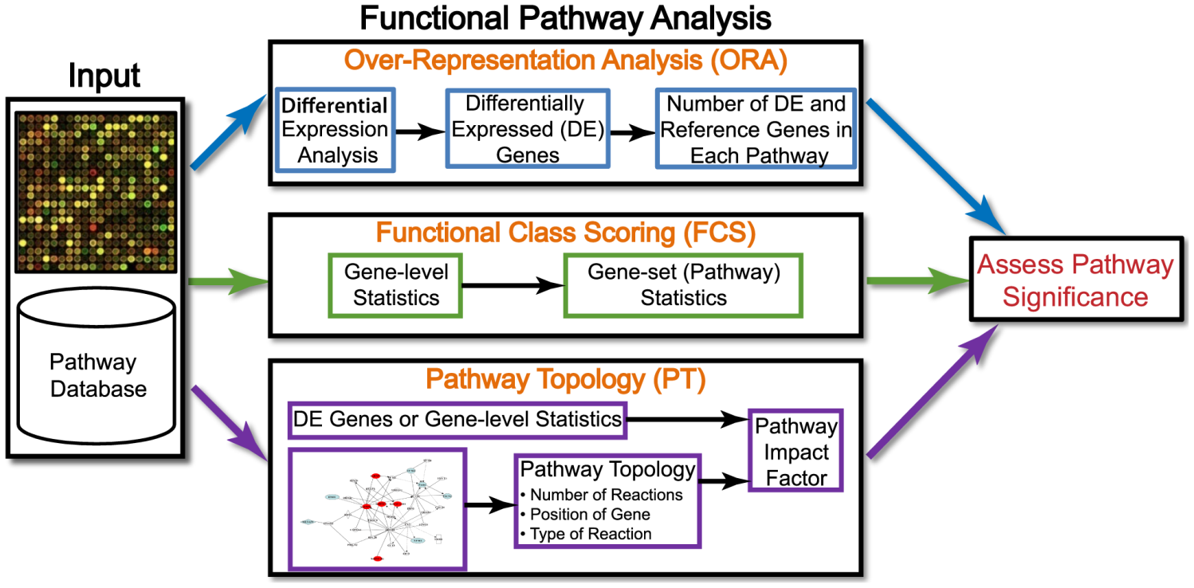
Types of Pathway Analysis
Khatri et alt. 10 years of Pathway Analysis

Slide 57
Types of input for Pathway Analysis
Gene list (e.g. expression change > 2-fold)
Answers the question: Are any gene sets surprisingly enriched (or depleted) in my gene list?
Statistical test: Fisher’s Exact Test (aka Hypergeometric test)
Ranked list (e.g. by differential expression)
Answers the question: Are any gene set ranked surprisingly high or low in my ranked list of genes?
Statistical test: minimum hypergeometric test (+ others we won’t discuss)

Slide 58
Types of Pathway Analysis depending on input and test performed
Over-representation Analysis
Takes a list of differentially expressed genes
Looks for “categories” that appear more often in the gene list than would be expected by chance,
Uses a hypergeometric /Fisher test approach
Intuitive and simple with many limitations
Gene Set Enrichment Analysis
Uses all genes, not only differentially expressed
Tests selected gene sets to see if number of genes on top of list of ranked comparisons is more abundant in gene set than would be expected by chance.
Uses K-S or wilcoxon test to compare distributions of test statistics.

Slide 59
Over-representation analysis
Pathway information:
All genes known to be involved in
Neurotransmitter signaling
Gene list from experiment:
Genes down-regulated in drug-
sensitive brain cancer cell lines
p<0.05 ?
Test many
pathways
Statistical test: are there more annotations in gene list than expected?
Hypothesis: drug sensitivity in brain cancer is
related to reduced neurotransmitter signaling

Slide 60
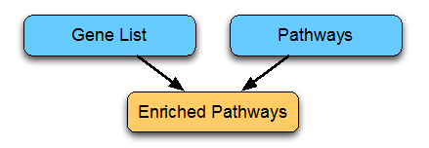
Over-representation analysis
Combines
Gene(feature) lists ← (Gen)omic experiment
Pathways and other gene annotations
Gene Ontology
Ontology Structure
Annotation
BioMart
Other resources

Slide 61
Enrichment Test
Spindle 0.00001
Apoptosis 0.00025
ENRICHMENT
TEST
Enrichment Table
Microarray
Experiment
(gene expression table)
Gene-set
Databases

Slide 62
Gene list enrichment analysis
Given:
Gene list: e.g. RRP6, MRD1, RRP7, RRP43, RRP42 (yeast)
Gene sets or annotations: e.g. Gene ontology, transcription factor binding sites in promoter
Question: Are any of the gene annotations surprisingly enriched in the gene list?
Details:
Where do the gene lists come from?
How to assess “surprisingly” (statistics)
How to correct for repeating the tests

Slide 63
Two-class design for gene lists
Genes Ranked by
Differential Statistic
Expression Matrix
Selection by Threshold
UP
UP
DOWN
DOWN
Class-1
Class-2
E.g.:
Fold change
Log (ratio)
t-test
Significance analysis of microarrays

Slide 64
Example gene list enrichment test
Microarray
Experiment
(gene expression table)
Gene list
(e.g UP-regulated)
Gene-set
Databases
Background
(all genes on the array)

Slide 65
Example gene list enrichment test
Microarray
Experiment
(gene expression table)
Gene list
(e.g UP-regulated)
Gene-set
Gene-set
Databases
Background
(all genes on the array)

Slide 66
Example gene list enrichment test
Given a list of differentially expressed genes and a collection of gene sets apply the following strategy
For each gene set fill a 2x2 contingency table
Calculate p-value using Fisher test
Compute FDR to adjust p-values for doing many tests
 | Differentially expressed | Not differentially expressed | TOTAL
In Gene Set | 10 | 30 | 40
Not In Gene Set | 390 | 3570 | 3960
TOTAL | 400 | 3600 | 4000
Warning: Background must be carefully chosen!

Slide 67
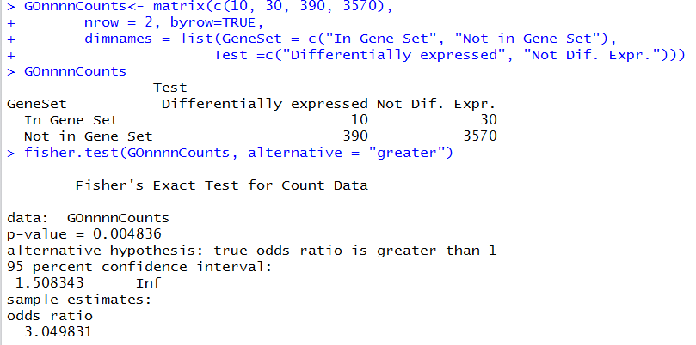
Naive Analysis: A Fisher test using R

Slide 68
Recipe for gene list enrichment test
Step 1: Define gene list (e.g. thresholding analyzed list ) and background list,
Step 2: Select gene sets to test for enrichment,
Step 3: Run enrichment tests and correct for multiple testing, if necessary,
Step 4: Interpret your enrichments
Step 5: Publish! ;)
Notes:
Consequtive basepairs

Slide 69
Possible problems with gene list test
No “natural” value for the threshold
Possible loss of statistical power due to thresholding
No resolution between significant signals with different strengths
Weak signals neglected
Different results at different threshold settings
Based on the wrong assumption of independent gene (or gene group) sampling, which increases false positive predictions

Slide 70
Alternative: Gene Set Testing
A gene set
a group of genes with related functions.
sets of genes or pathways, for their association with a phenotype.
Examples: metabolic pathway, protein complex, or GO (gene ontology) category.
Identified from a prior biological knowledge.
May better reflect the true underlying biology.
May be more appropriate units for analysis.

Slide 71
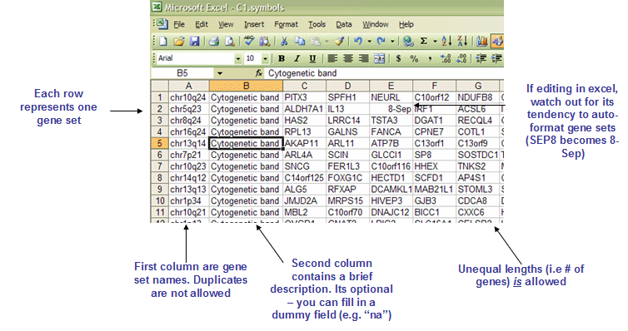
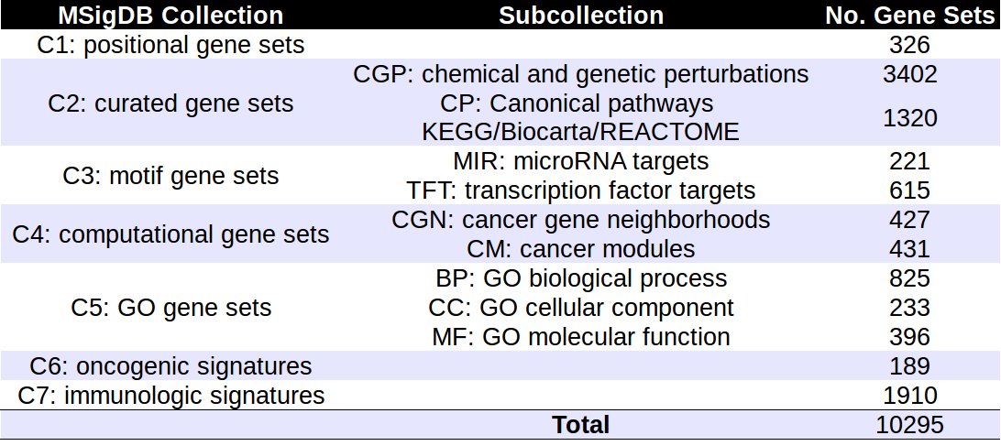
Gene Sets

Slide 72
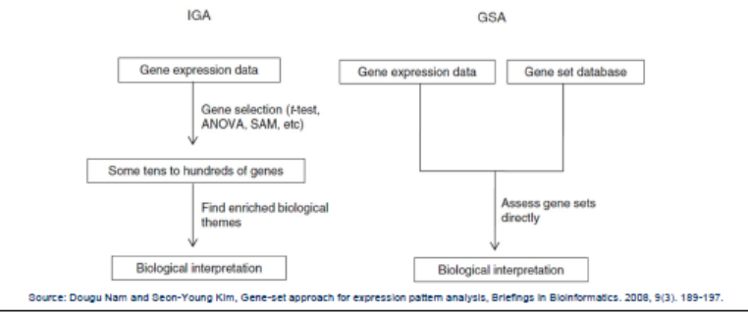
Gene Set (Enrichment) Analysis
Introduced by Mootha (2003) as an alternative to ORA.
It aims to identify gene sets with subtle but coordinated expression changes that cannot be detected by ORA methods.
Weak changes in individual genes gathered to large gene sets can show a significant pattern.
Results of GSA are not affece by arbitrarily chosen cutoffs.
It does not provide information as detailed as ORA

Slide 73
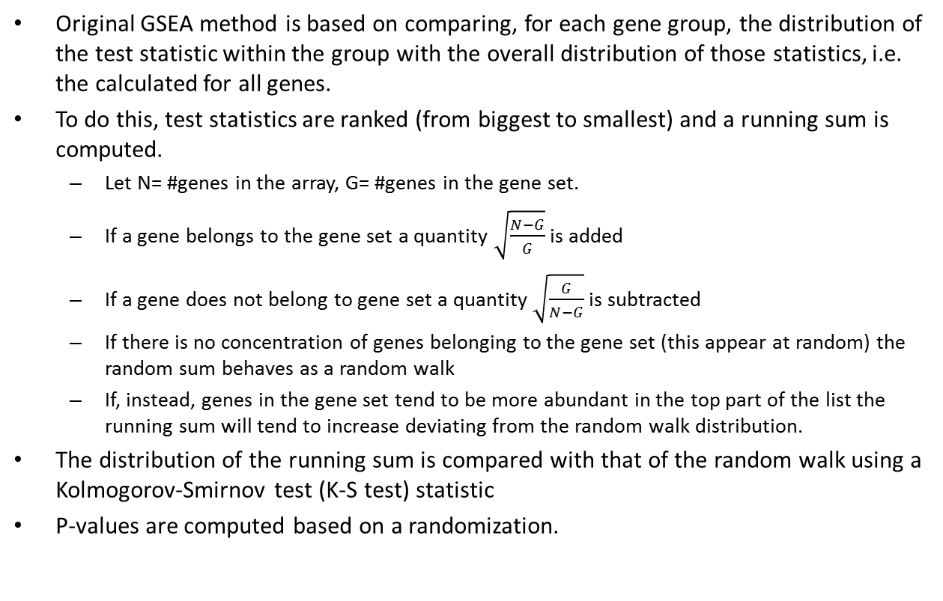
The GSEA method
Original GSEA method is based on comparing, for each gene group, the distribution of the test statistic within the group with the overall distribution of those statistics, i.e. the calculated for all genes.
To do this, test statistics are ranked (from biggest to smallest) and a running sum is computed.
Let N= #genes in the array, G= #genes in the gene set.
If a gene belongs to the gene set a quantity $\sqrt{\frac{N−G}{G}}$ is added
If a gene does not belong to gene set a quantity $\sqrt{\frac{G}{N−G}}$is subtracted
If there is no concentration of genes belonging to the gene set (this appear at random) the random sum behaves as a random walk
If, instead, genes in the gene set tend to be more abundant in the top part of the list the running sum will tend to increase deviating from the random walk distribution.
The distribution of the running sum is compared with that of the random walk using a Kolmogorov-Smirnov test (K-S test) statistic
P-values are computed based on a randomization.

Slide 74
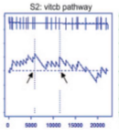
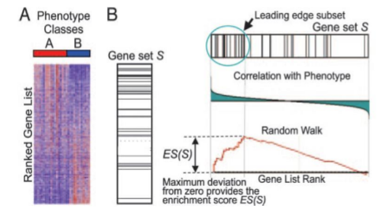
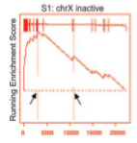
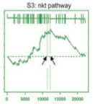
The GSEA method

Slide 75
Recipe for ranked list enrichment test
Step 1: Rank ALL your genes,
Step 2: Select gene sets to test for enrichment,
Step 3: Run enrichment tests and correct for multiple testing, if necessary,
Step 4: Interpret your enrichments
Step 5: Publish! ;)
Notes:
Consequtive basepairs

Slide 76
GSEA variants
GSEA is not free from criticisms
Use of KS test
Null hypothesis is not clear
Many alternative available
Efron’s GSA
Limma’s ROAST
Irizarry’s simple GSA based on Wilcoxon…

Slide 77
Multiple test corrections

Slide 78
How to win the P-value lottery
Random draws
… 7,834
draws later …
Expect a random draw with observed enrichment once every : “1 / P-value “ draws
Background population:
500 black genes,
4500 red genes
Notes:
Whenever you do multiple tests, need to correct the p-values
Remind audience of p-value definition
Motivating example: Do 20 tests at a p-value of 0.05, expect one false positive

Slide 79
Simple P-value correction: Bonferroni
If M = # of annotations tested:
Corrected P-value = M x original P-value
Corrected P-value is greater than or equal to the probability that one or more of the observed enrichments could be due to random draws.
The jargon for this correction is “controlling for the Family-Wise Error Rate (FWER)”

Slide 80
Bonferroni correction caveats
Bonferroni correction is very stringent and can “wash away” real enrichments leading to false negatives,
Often one is willing to accept a less stringent condition, the “false discovery rate” (FDR), which leads to a gentler correction when there are real enrichments.

Slide 81
False discovery rate (FDR)
FDR is the expected proportion of the observed enrichments due to random chance.
Compare to Bonferroni correction which is a bound on the probability that any one of the observed enrichments could be due to random chance.
Typically FDR corrections are calculated using the Benjamini-Hochberg procedure.
FDR threshold is often called the “q-value”

Slide 82
Benjamini-Hochberg example I
(Nominal)
P-value
Rank
Category
1
2
3
4
5
…
52
53
Transcriptional regulation
Transcription factor
Initiation of transcription
Nuclear localization
Chromatin modification
…
Cytoplasmic localization
Translation
0.001
0.002
0.003
0.0031
0.005
…
0.97
0.99
Sort P-values of all tests in decreasing order

Slide 83
Benjamini-Hochberg example II
(Nominal)
P-value
Rank
Category
Adjusted P-value
1
2
3
4
5
…
52
53
Transcriptional regulation
Transcription factor
Initiation of transcription
Nuclear localization
Chromatin modification
…
Cytoplasmic localization
Translation
0.001
0.002
0.003
0.0031
0.005
…
0.97
0.99
0.001 x 53/1 = 0.053
0.002 x 53/2 = 0.053
0.003 x 53/3 = 0.053
0.0031 x 53/4 = 0.040
0.005 x 53/5 = 0.053
…
0.985 x 53/52 = 1.004
0.99 x 53/53 = 0.99
Adjusted P-value is “nominal” P-value times # of tests divided by the rank of the P-value in sorted list
Adjusted P-value = P-value X [# of tests] / Rank

Slide 84
Benjamini-Hochberg example III
(Nominal)
P-value
FDR /
Q-value
Rank
Category
Adjusted P-value
1
2
3
4
5
…
52
53
Transcriptional regulation
Transcription factor
Initiation of transcription
Nuclear localization
Chromatin modification
…
Cytoplasmic localization
Translation
0.001
0.002
0.003
0.0031
0.005
…
0.97
0.99
0.001 x 53/1 = 0.053
0.002 x 53/2 = 0.053
0.003 x 53/3 = 0.053
0.0031 x 53/4 = 0.040
0.005 x 53/5 = 0.053
…
0.985 x 53/52 = 1.004
0.99 x 53/53 = 0.99
0.040
0.040
0.040
0.040
0.053
…
0.99
0.99
Q-value (or FDR) corresponding to a nominal P-value is the smallest adjusted P-value assigned to P-values with the same or larger ranks.

Slide 85
Benjamini-Hochberg example III
P-value threshold for FDR < 0.05
FDR /
Q-value
(Nominal)
P-value
Rank
Category
Adjusted P-value
1
2
3
4
5
…
52
53
Transcriptional regulation
Transcription factor
Initiation of transcription
Nuclear localization
Chromatin modification
…
Cytoplasmic localization
Translation
0.001
0.002
0.003
0.0031
0.005
…
0.97
0.99
0.001 x 53/1 = 0.053
0.002 x 53/2 = 0.053
0.003 x 53/3 = 0.053
0.0031 x 53/4 = 0.040
0.005 x 53/5 = 0.053
…
0.985 x 53/52 = 1.004
0.99 x 53/53 = 0.99
0.040
0.040
0.040
0.040
0.053
…
0.99
0.99
Red: non-significant
Green: significant at FDR < 0.05
P-value threshold is highest ranking P-value for which corresponding Q-value is below desired significance threshold

Slide 86
Reducing correction stringency
The correction to the P-value threshold depends on the # of tests that you do,
so, no matter what, the more tests you do, the more sensitive the test needs to be
Can control the stringency by reducing the number of tests:
e.g. use GO slim;
restrict testing to the appropriate GO annotations;
or filter gene sets by size.

Slide 87
Tools for Pathway Analysis

Slide 88
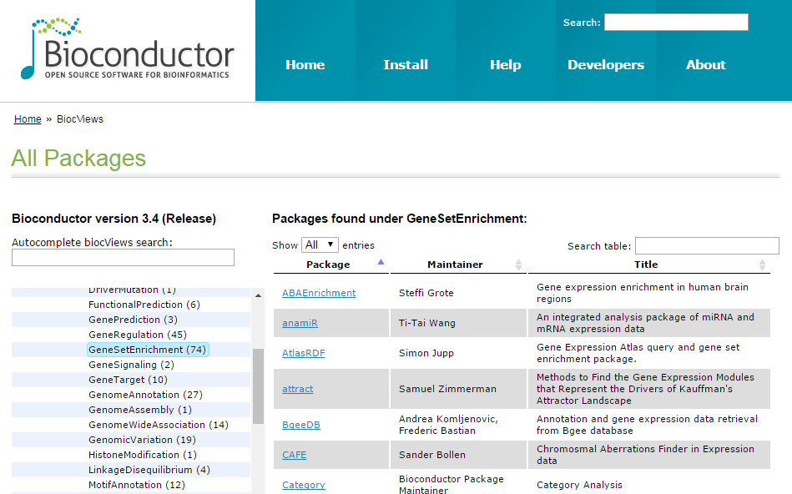
R/Bioconductor
As of March 2017 there are 74 packages under the view “Gene Set Enrichment”

Slide 89
Other (non-R) pathway analysis tools
DAVID
Pathway Painter
Babelomics
GenMAPP (www. genmapp.com)
WikiPathways (www. wikipathways.org)
cPath (cbio.mskcc.org/cpath)
BioCyc (www.biocyc.org)
Pubgene (www.pubgene.org)
PANTHER (www. pantherdb.org)
WebGestalt (bioinfo.vanderbilt.edu/webgestalt/)
ToppGeneSuite (/toppgene.cchmc.org/)
GeneGo/MetaCore (www.genego.com)
Ingenuity Pathway Analysis (www.ingenuity.com)
Pathway Studio (www. ariadnegenomics.com)

Slide 90
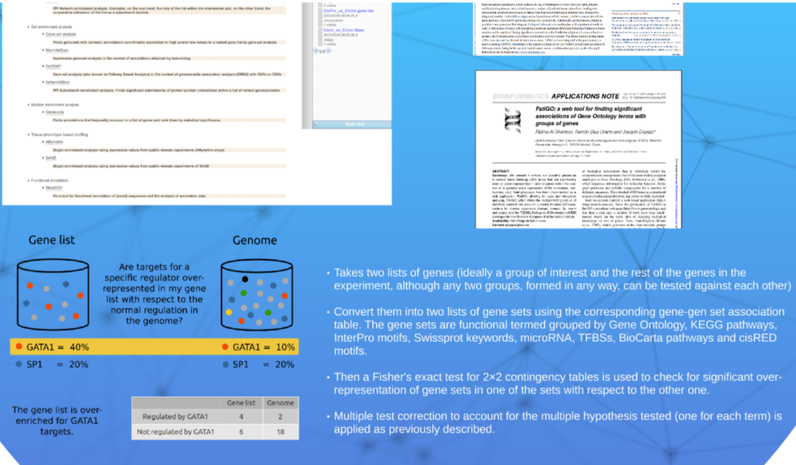
BABELOMICS (FATIGO et alt.)
6. Example tool: BABELOMICS (FATIGO)

Slide 91
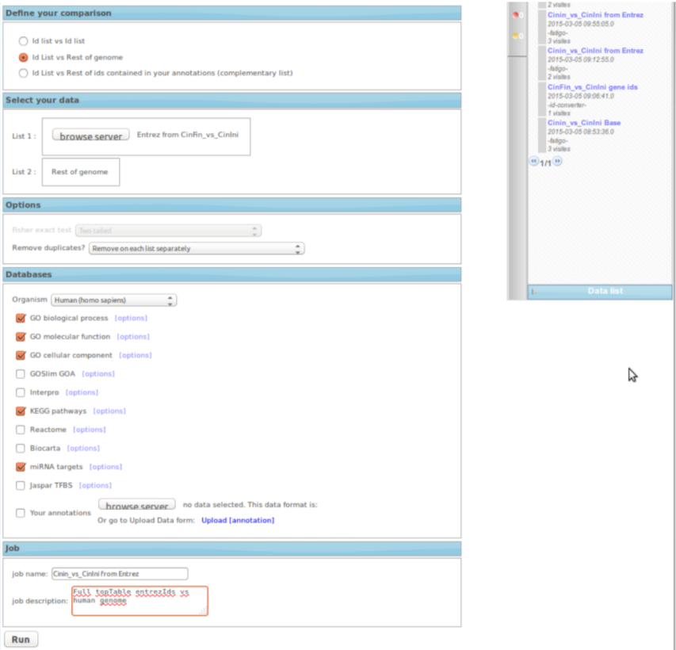
Upload gene list, set parameters
6. Example tool: BABELOMICS (FATIGO)

Slide 92
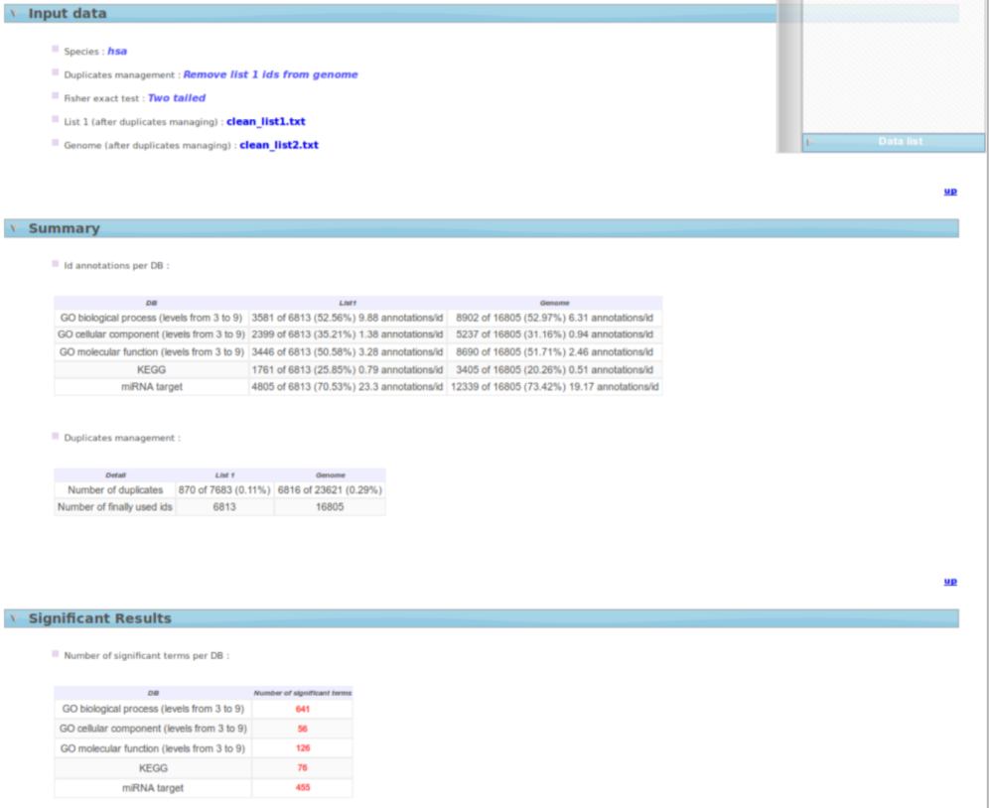
Obtain “significantly enriched” sets
6. Example tool: BABELOMICS (FATIGO)

Slide 93
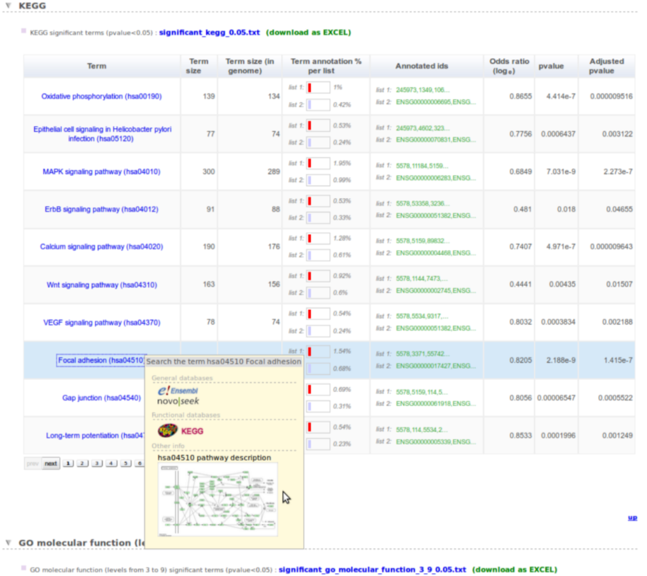
Visualize results
6. Example tool: BABELOMICS (FATIGO)

Slide 94
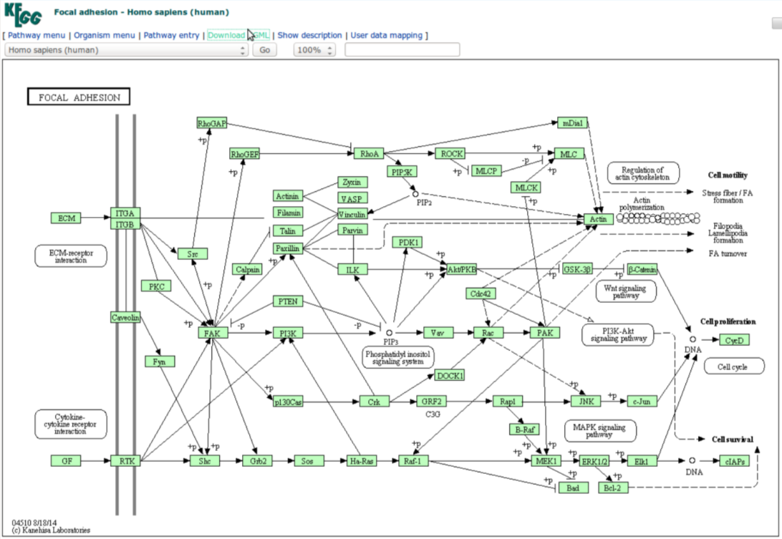
Visualize results
6. Example tool: BABELOMICS (FATIGO)

Slide 95
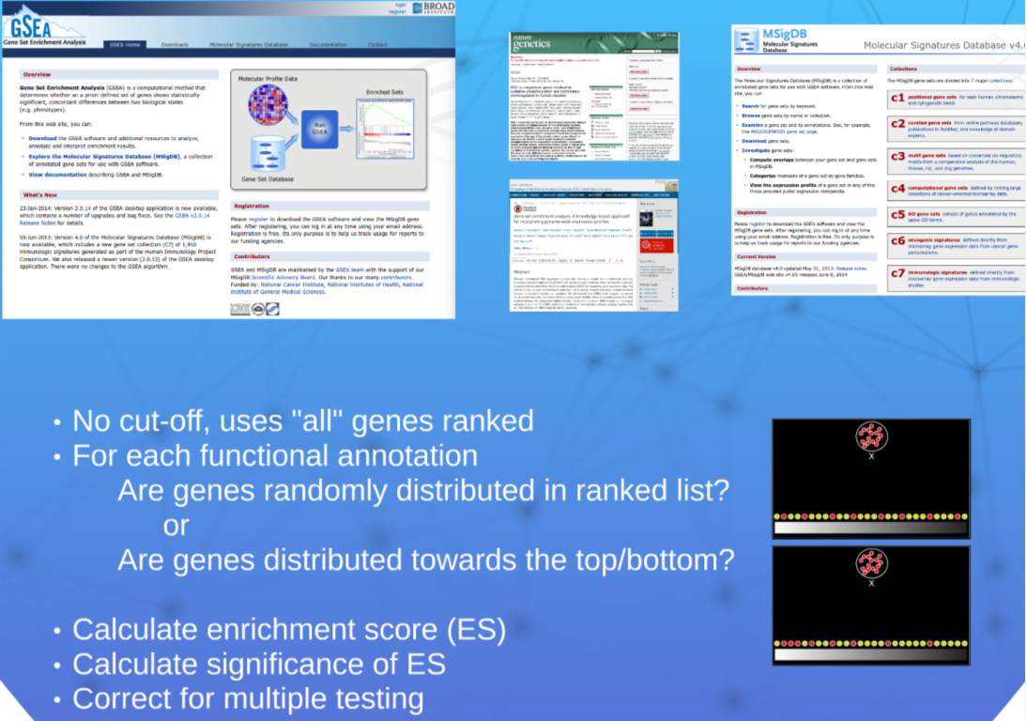
“Official” GSEA. BROAD Institute
6. Example tool: GSEA

Slide 96
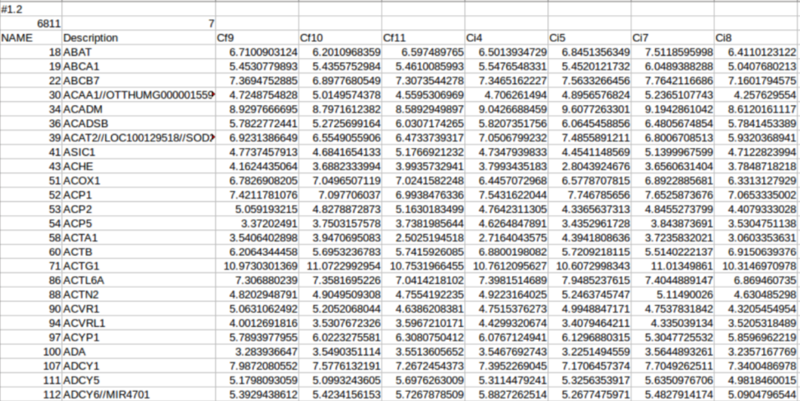
Upload data matrix (not gene list!)
6. Example tool: GSEA

Slide 97
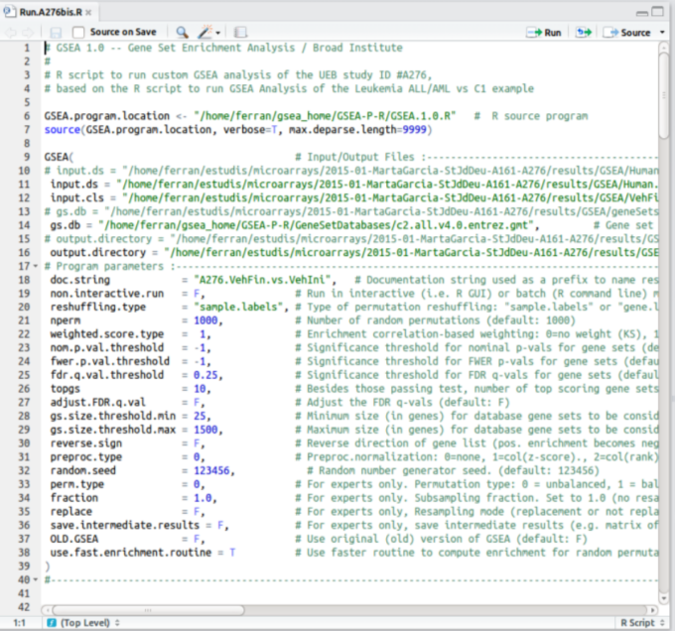
Set analysis parameters and gene sets
6. Example tool: GSEA

Slide 98

Get results. Interpret output
6. Example tool: GSEA

Slide 99

DAVID
6. Example tool: DAVID

Slide 100

Upload gene lists. Define background
6. Example tool: DAVID

Slide 101

Results
6. Example tool: DAVID

Slide 102

Results
6. Example tool: DAVID

Slide 103

Results
6. Example tool: DAVID

Slide 104

Ingenuity Pathways
6. Example tool: Ingenuity Pathway Analysis

Slide 105
Exercise
Obtain a gene list and a background list from a differential expression analysis (background may be the list of all genes analyzed) (see next slide)
Convert identifiers into “Entrez” ids if they are not already converted.
Select two pathway analysis tools e.g. DAVID and Babelomics
Do a Gene Enrichment Analysis with each tool.
Compare the 5-10 top enriched categories and comment about the differences.
Alternatively do it with R/Bioconductor with the code from the following slides.

Slide 106
R code to prepare the data
topTab <- read.table(https://raw.githubusercontent.com/alexsanchezpla/scripts/master/Exemple_Analisis_BioC/results/ExpressAndTop_AvsB.csv2,head=TRUE, sep=";", dec=",")
colnames(topTab)
head(topTab)
geneListUp <- unique( topTab$EntrezsA [topTab$adj.P.Val<0.05 & topTab$logFC > 0] )
length(geneListUp)
geneListDown <- unique( topTab$EntrezsA [topTab$adj.P.Val<0.05 & topTab$logFC < 0] )
length(geneListDown)
geneUniverse <- unique(topTab$EntrezsA)
length(geneUniverse)
write.csv(geneListUp, file="selectedAvsB.up.csv")
write.csv(geneListDown, file="selectedAvsB.down.csv")
write.csv(geneUniverse, file="geneUniverse.csv")

Slide 107
A quick ORA analysis with R
# GOAnalysis
require(GOstats)
## Creamos los "hiperparametros" en que se basa el analisis
GOparams = new("GOHyperGParams",
geneIds=geneListUp, universeGeneIds=geneUniverse, annotation="org.Hs.eg.db", ontology="BP",
pvalueCutoff=0.001, conditional=FALSE, testDirection="over")
KEGGparams = new("KEGGHyperGParams",
geneIds=geneListUp, universeGeneIds=geneUniverse,
annotation="org.Hs.eg.db", pvalueCutoff=0.01, testDirection="over")
## Ejecutamos los analisis
GOhyper = hyperGTest(GOparams)
KEGGhyper = hyperGTest(KEGGparams)
cat("GO\n"); print(head(summary(GOhyper)))
cat("KEGG\n"); print(head(summary(KEGGhyper)))
# Creamos un informe html con los resultados
GOfilename =file.path(paste("GOResults.",".html", sep=""))
KEGGfilename =file.path(paste("KEGGResults.",".html", sep=""))
htmlReport(GOhyper, file = GOfilename, summary.args=list("htmlLinks"=TRUE))
htmlReport(KEGGhyper, file = KEGGfilename, summary.args=list("htmlLinks"=TRUE))

Slide 108


Expected output

Slide 109
Summary
Pathway Analysis is a useful approach to help gain biological understanding from omics-based studies.
There are many ways, many methods, many tools →
Choice of the method should be guided by
a combination of availability, ease of use and usefulness ,
Usually obtained from a good understanding of how it
Different methods may yield different results
Worth checking!

Slide 110
References
Efron, Bradley, and Robert Tibshirani. 2007. “On Testing the Significance of Sets of Genes.” The Annals of Applied Statistics 1 (1): 107–29. doi:10.1214/07-AOAS101.
Irizarry, Rafael A., Chi Wang, Yun Zhou, and Terence P. Speed. 2009. “Gene Set Enrichment Analysis Made Simple.” Statistical Methods in Medical Research 18 (6): 565–75. doi:10.1177/0962280209351908.
Khatri, Purvesh, and Sorin Drăghici. 2005. “Ontological Analysis of Gene Expression Data: Current Tools, Limitations, and Open Problems.” Bioinformatics (Oxford, England) 21 (18): 3587–95. doi:10.1093/bioinformatics/bti565.
Khatri, Purvesh, Marina Sirota, and Atul J. Butte. 2012. “Ten Years of Pathway Analysis: Current Approaches and Outstanding Challenges.” PLOS Computational Biology 8 (2): e1002375. doi:10.1371/journal.pcbi.1002375.
Maciejewski, Henryk. 2014. “Gene Set Analysis Methods: Statistical Models and Methodological Differences.” Briefings in Bioinformatics 15 (4): 504–18. doi:10.1093/bib/bbt002.
Mootha, Vamsi K., Cecilia M. Lindgren, Karl-Fredrik Eriksson, Aravind Subramanian, Smita Sihag, Joseph Lehar, Pere Puigserver, et al. 2003. “PGC-1α-Responsive Genes Involved in Oxidative Phosphorylation Are Coordinately Downregulated in Human Diabetes.” Nature Genetics 34 (3): 267–73. doi:10.1038/ng1180.
Pan, Kuang-Hung, Chih-Jian Lih, and Stanley N. Cohen. 2005. “Effects of Threshold Choice on Biological Conclusions Reached during Analysis of Gene Expression by DNA Microarrays.” Proceedings of the National Academy of Sciences of the United States of America 102 (25): 8961–65. doi:10.1073/pnas.0502674102.
Subramanian, Aravind, Pablo Tamayo, Vamsi K. Mootha, Sayan Mukherjee, Benjamin L. Ebert, Michael A. Gillette, Amanda Paulovich, et al. 2005. “Gene Set Enrichment Analysis: A Knowledge-Based Approach for Interpreting Genome-Wide Expression Profiles.” Proceedings of the National Academy of Sciences of the United States of America 102 (43): 15545–50. doi:10.1073/pnas.0506580102.
the Mutation Consequences and Pathway Analysis working group of the International Cancer Genome Consortium. 2015. “Pathway and Network Analysis of Cancer Genomes.” Nature Methods 12 (7): 615–21. doi:10.1038/nmeth.3440.

Slide 111













Acknowledgements

